Slide 1

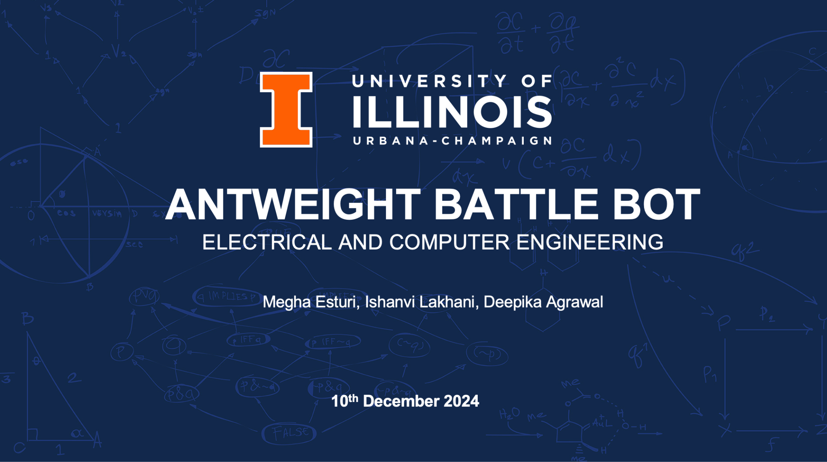

Slide 2

TEAM PROJECT – ANTWEIGHT BATTLE BOT
Weight should be under 2lbs
3D printed using PLA plastic
Flipper arm as the defense mechanism
Communicates with the PC using over WIFI
UNIVERSITY OF ILLINOIS URBANA-CHAMPAIGN
GRAINGER ENGINEERING
Notes:
DEPIKAA

Slide 3
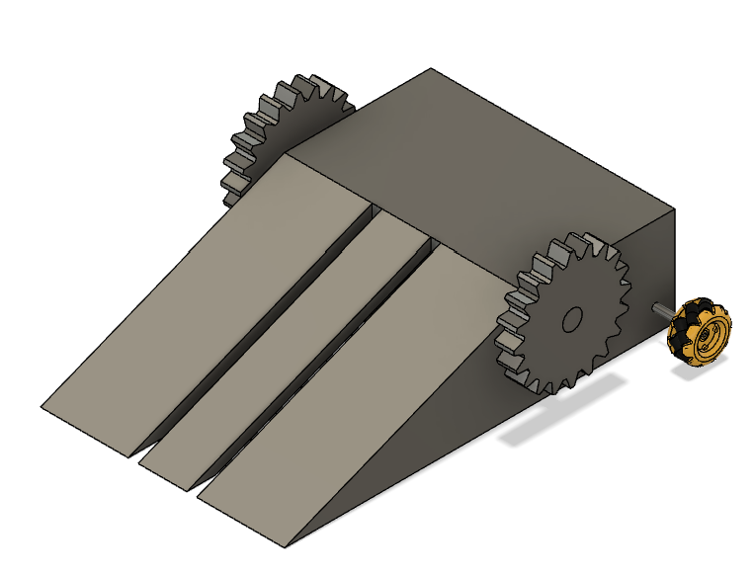
ORIGINAL DESIGN - 2 DEFENSE MECHANISMS
VERTICAL SPINNER + FLIPPER ARM
Unbalanced as only 2 wheels at the back
Over 2 lbs due to extra motors for the spinners
Spinners needed to be really big for defense
added a lot of weight and not practical
UNIVERSITY OF ILLINOIS URBANA-CHAMPAIGN
GRAINGER ENGINEERING
Notes:
DEPEEKA

Slide 4
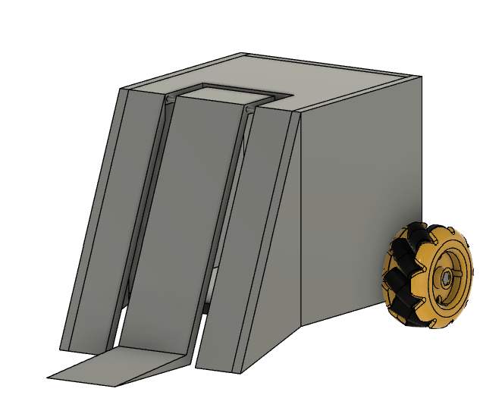
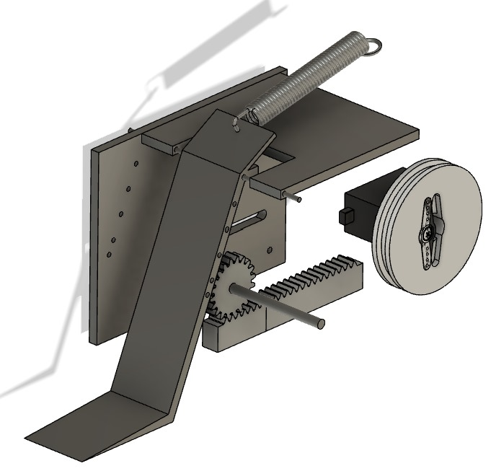
UPDATED DESIGN
ONE FLIPPER ARM
Unbalanced as only 2 wheels at the back
Over 2 lbs due to an extra motor for the flipper arm
Weak and slow defense with no locking mechanism
Rack and pinion mechanism unstable
Flipper arm unable to lift 2lbs
UNIVERSITY OF ILLINOIS URBANA-CHAMPAIGN
GRAINGER ENGINEERING
Notes:
DIPEAKA

Slide 5
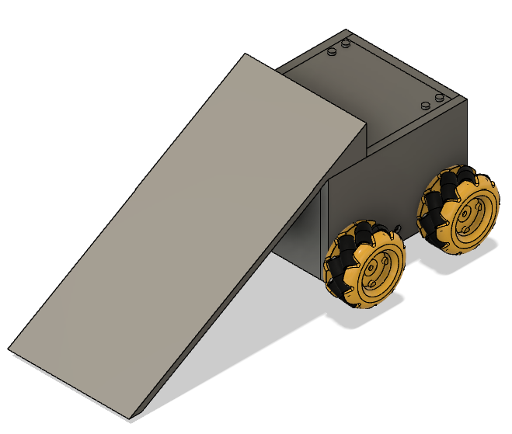
FINAL DESIGN
SINGLE RAMP WITH FOUR WHEELS
Well balanced – 4 wheel drive
Under 2 lbs – no extra motors required
Ramp causes opponent to destabilize when they are moving fast towards our ramp
We can also back them into an area
UNIVERSITY OF ILLINOIS URBANA-CHAMPAIGN
GRAINGER ENGINEERING
Notes:
DEAPIKA

Slide 6
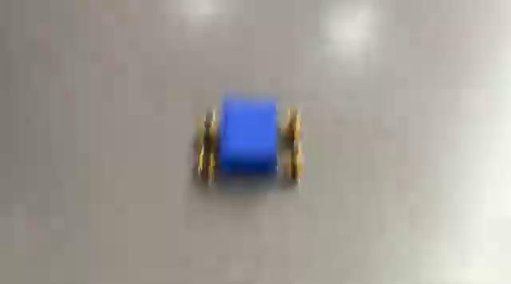
VIDEO OF FUNCTIONAL BATTLEBOT
UNIVERSITY OF ILLINOIS URBANA-CHAMPAIGN
GRAINGER ENGINEERING
Notes:
there are no ramps in this video because at this point the filament had just been refilled in the mab, and we were still printing our ramp
DEEPIKAAAA

Slide 7

PROJECT BUILD AND FUNCTIONAL TEST RESULTS
UNIVERSITY OF ILLINOIS URBANA-CHAMPAIGN
GRAINGER ENGINEERING

Slide 8
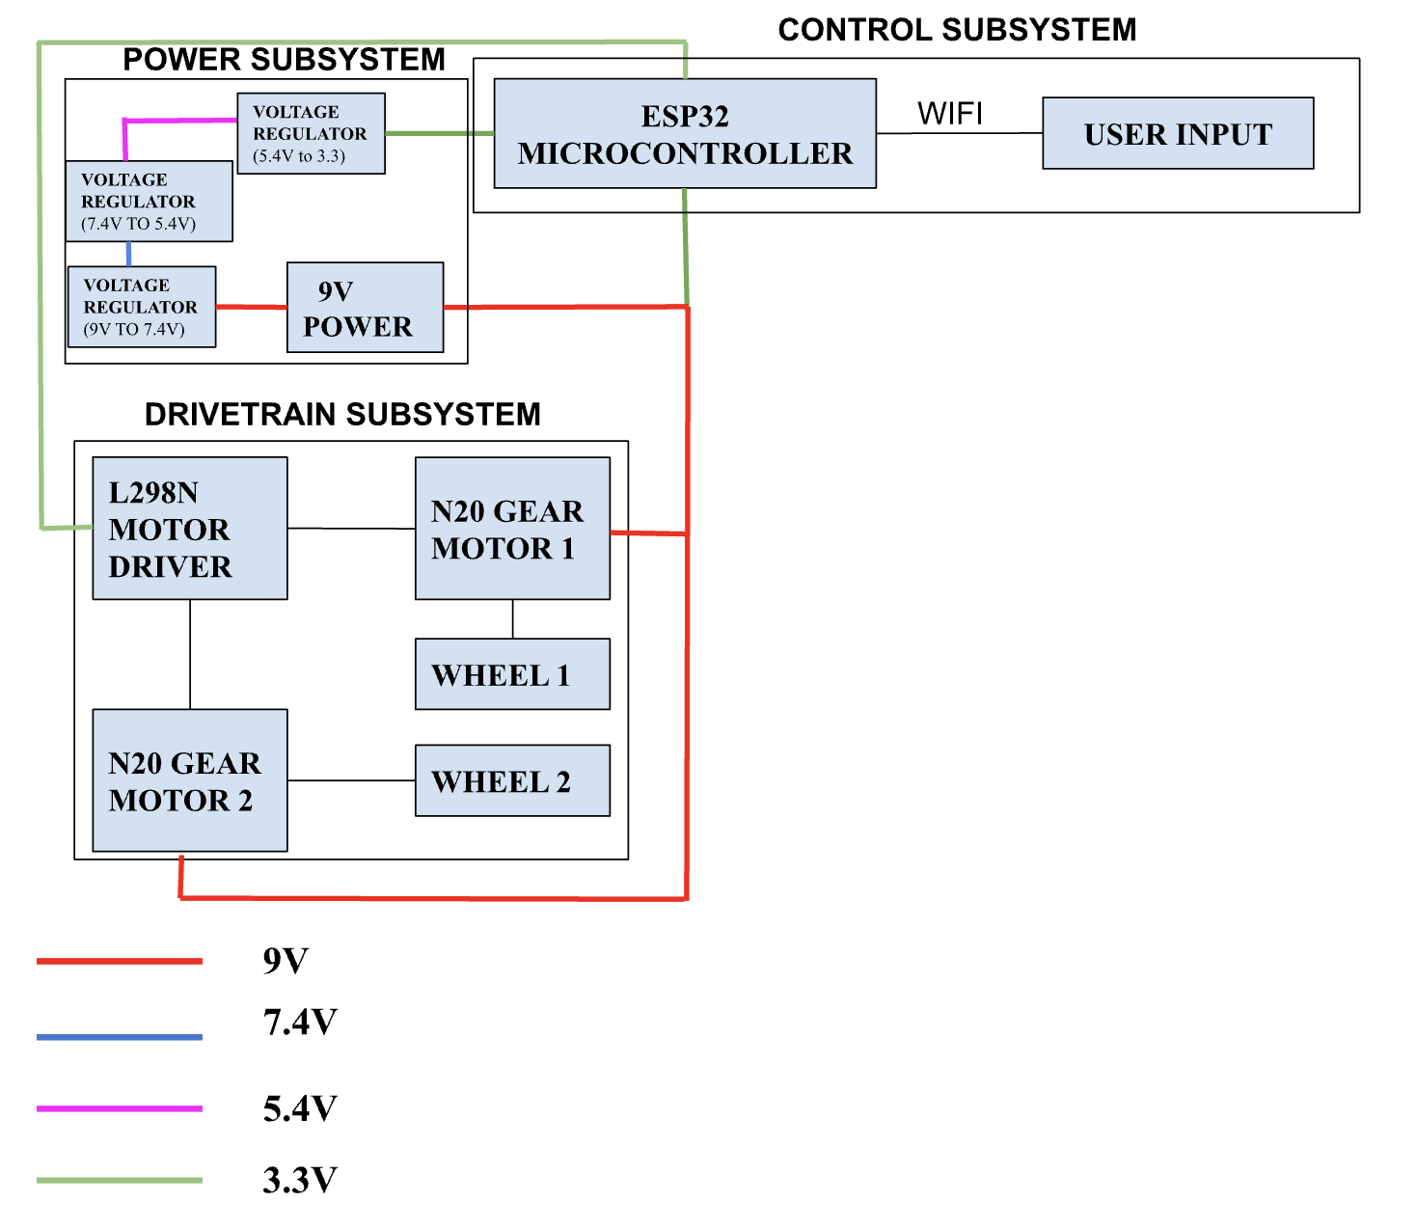
BLOCK DIAGRAM
UNIVERSITY OF ILLINOIS URBANA-CHAMPAIGN
GRAINGER ENGINEERING
Notes:
MEGHA

Slide 9


SOFTWARE COMPONENT
Platform: Arduino
Website: HTML, CSS, JavaScript
Connection through Wifi
7 Main Functions
connectToWifi()
U → accelerateForward()
D → accelerateBackward()
L → turnLeft()
R → turnRight()
S → immediateStop()
failsafeCheck()
U
L
s
R
D
UNIVERSITY OF ILLINOIS URBANA-CHAMPAIGN
GRAINGER ENGINEERING
Notes:
MEGHAA

Slide 10
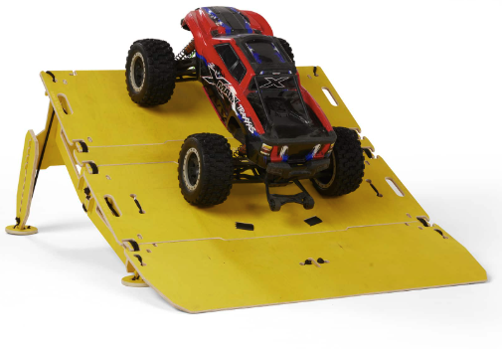
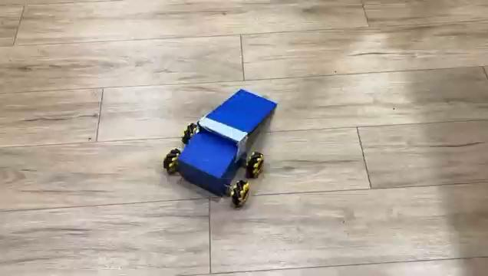
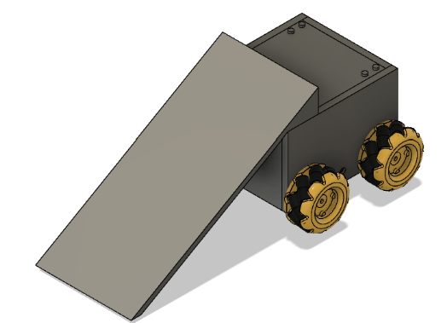
FLIPPING SUBSYSTEM - REQUIREMENT 1
Destabilizing Force: The should generate enough force to destabilize the opponent robot.
UNIVERSITY OF ILLINOIS URBANA-CHAMPAIGN
GRAINGER ENGINEERING
Notes:
MEGHA

Slide 11
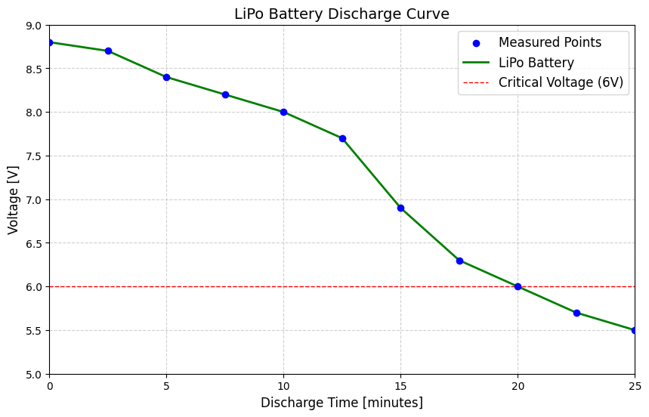
POWER SUBSYSTEM - REQUIREMENT 1
The subsystem must include a 9V battery to power the bot for about 3-5 minutes which is what we expect the duration of the battle to be.
We ran the battlebot and measured the voltage being supplied by the battery
Critical voltage = 6V = ideal voltage at which our motors need to function well
UNIVERSITY OF ILLINOIS URBANA-CHAMPAIGN
GRAINGER ENGINEERING
Notes:
ISHONVI

Slide 12
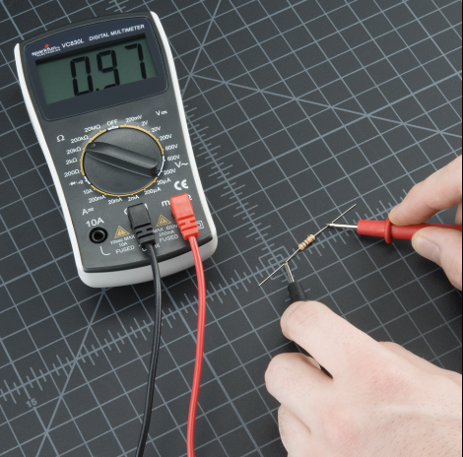
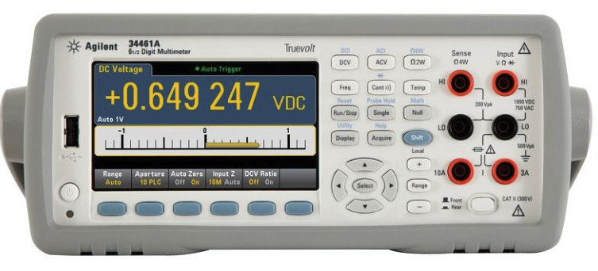
DRIVETRAIN SUBSYSTEM - REQUIREMENT 1
The motors and motor drivers must operate efficiently with a 9V battery.
UNIVERSITY OF ILLINOIS URBANA-CHAMPAIGN
GRAINGER ENGINEERING
Notes:
MEGHA

Slide 13
DRIVETRAIN SUBSYSTEM - REQUIREMENT 2
2. The wheels must enable the robot to move at a sufficient speed, achieving an RPM of approximately 50 - 460 .
Circumference= π × Diameter= π × 0.048m ≈ 0.1508m
Speed= Distance​ / Time
Rotations per Second = Circumference / Speed​
RPM = Rotations per Second × 60
Weight Added | Distance (meters) | Time (sec) | RPM (Theory) | RPM (Actual)
None | 10 | 22.1 | 450 | 180
1.2lbs | 10 | 49.74 | 450 | 80
UNIVERSITY OF ILLINOIS URBANA-CHAMPAIGN
GRAINGER ENGINEERING
Notes:
MEGHA

Slide 14
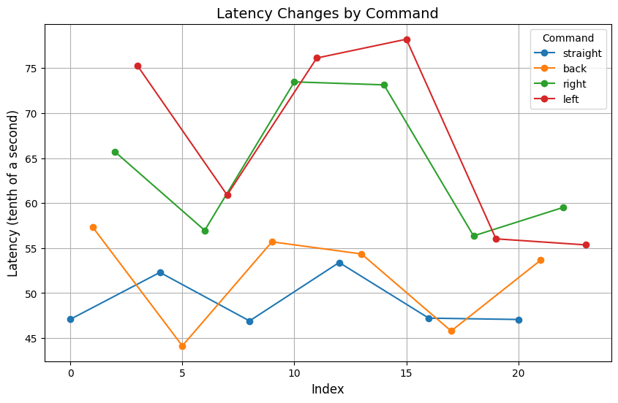
CONTROL SUBSYSTEM - REQUIREMENT 1
The latency should be between 50-100 tenth of a second for responsive control.
We timed the latency per command and used the following values
Average latency = 58ms .
Command Sent | Latency (tenths of a second)
Straight | 45.39
Back | 44.97
Right | 61.61
Left | 59.73
UNIVERSITY OF ILLINOIS URBANA-CHAMPAIGN
GRAINGER ENGINEERING
Notes:
ISHONVIII

Slide 15


CONTROL SUBSYSTEM - REQUIREMENT 2
2. The battlebot should stop operating if WIFI connection is lost as a safety precaution (kill switch)
UNIVERSITY OF ILLINOIS URBANA-CHAMPAIGN
GRAINGER ENGINEERING
Notes:
ISHOBVI

Slide 16

CONTROL SUBSYSTEM - REQUIREMENT 3
3. The battlebot should be able to receive commands and execute them up to a distance of 8.48ft
UNIVERSITY OF ILLINOIS URBANA-CHAMPAIGN
GRAINGER ENGINEERING
Notes:
ISHANVI

Slide 17
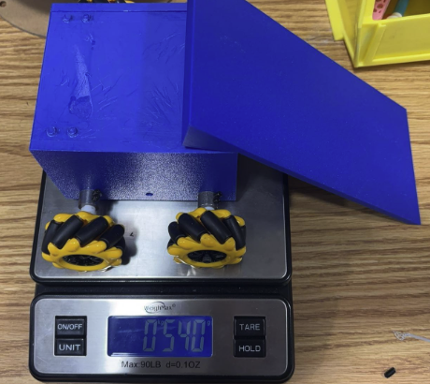

SUCCESSES OF THE PROJECT
Met all of our high level requirements:
1. The total weight of the battle bot must not exceed 2 lbs.
2. The Wi-Fi communication range indoors should be between 8 - 25 ft with the battle bot’s response time being 50 - 100 tenths of a second.
3. The battlebot must be able to flip/destabilize an opponent bot weighing about 2 lbs.
UNIVERSITY OF ILLINOIS URBANA-CHAMPAIGN
GRAINGER ENGINEERING
Notes:
ISAHBNI

Slide 18
WHAT WE WOULD DO DIFFERENTLY
Use different wheels
Use bigger and sturdier motors
Establish concrete deadline for the CAD design
Start testing our PCB earlier
UNIVERSITY OF ILLINOIS URBANA-CHAMPAIGN
GRAINGER ENGINEERING
Notes:
ISAHNVI

Slide 19
SUMMARY
Successfully designed the bot
Met all our high level requirements
Learnt a lot about both the electrical and mechanical aspect of the project
UNIVERSITY OF ILLINOIS URBANA-CHAMPAIGN
GRAINGER ENGINEERING
Notes:
ISAHVNI

Slide 20
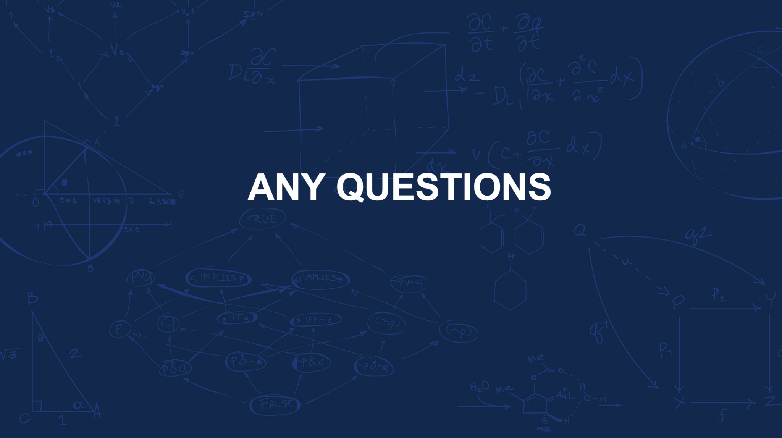

Slide 21


